Slide 1
Project „ACH“ (Applied Crypto Hardening)
www.bettercrypto.org

Slide 2

Motivation
(Aaron)

Slide 3
Don‘t give them anything for free
It‘s your home, you fight

Slide 4
TL;DR - Quickinfos
Website: www.bettercrypto.org
Git repo: https://git.bettercrypto.org
Mailing list: http://lists.cert.at/cgi-bin/mailman/listinfo/ach

Slide 5
Idea
(Aaron)
Do at least something against the Cryptocalypse
Check SSL, SSH, PGP crypto Settings in the most common services and certificates:
Apache, Nginx, lighthttp
IMAP/POP servers (dovecot, cyrus, ...)
openssl.conf
Etc.
Create easy, copy & paste-able settings which are „OK“ (as far as we know) for sysadmins.
Keep it short. There are many good recommendations out there written by cryptographers for cryptographers
Many eyes must check this!

Slide 6
Who?
(Aaron)
Wolfgang Breyha (uni VIE), David Durvaux (CERT.be), Tobias Dussa (KIT.edu CERT), L. Aaron Kaplan (CERT.at), Christian Mock (coretec), Daniel Kovacic (A-Trust), Manuel Koschuch (FH Campus Wien), Adi Kriegisch (VRVis), Ramin Sabet (A-Trust), Aaron Zauner (azet.org), Pepi Zawodsky (maclemon.at),
IAIK: ??
A-Sit: ??

Slide 7
Contents so far
(Aaron)
Disclaimer
Methods
Elliptic Curve Cryptography
Keylengths
Random Number Generators
Cipher suites – general overview & how to choose one
Recommendations on practical settings
Tools
Links
Notes:
Green == main chapter

Slide 8
Methods
How we develop this whitepaper
Public review
We need your review!
Aaron

Slide 9
Some thoughts on ECC
Currently this is under heavy debate
Might have to change settings tomorrow
Doubts about the security of certain curves (NIST curves)
Ramin, Daniel

Slide 10
Keylengths
http://www.keylength.com/
For RSA: >= 2048 bits
For ECC: >= 256
TODO aaron: keylengths.com screenshot or we show it live
Ramin, Daniel

Slide 11
Forward Secrecy
DHE: ephemeral keys
PFS ==
Pro:
Contra:
TODO: Daniel, Ramin
Ramin, Daniel

Slide 12
RNGs
Entropy after startup: embedded devices
Dual EC_DRBG is known weak (RSA used it)
Daniel: Paper (Lenstra?) 2%-5% of p,q was guessable
Use tools such as HavGE to increase entropy
RNGs are important.
Re-generate keys from time to time
Intel RNG: ? It does not harm to add it. Entropy only goes up (in the long run).
Ramin, Daniel

Slide 13
Attacks
Ramin, Daniel

Slide 14
Attacks
Beast
Lucky 13
.... TODO Daniel
Ramin, Daniel

Slide 15
Cipher suites

Slide 16
Some general thoughts on settings
General
Disable SSL 2.0 (weak algorithms)
Disable SSL 3.0 (BEAST vs IE/XP)
Enable TLS 1.0 or better
Disable TLS-Compression (SSL-CRIME Attack)
Implement HSTS (HTTP Strict Transport Security)
Variant A: fewer supported clients
Variant B: more clients, weaker settings
Ramin, Daniel

Slide 17
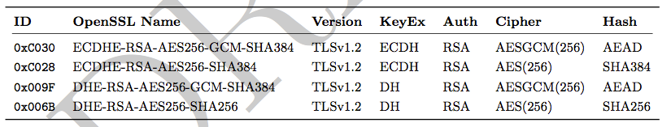
Variant A
’EECDH+aRSA+AES256:EDH+aRSA+AES256:!SSLv3’
Compatibility:
Only clients which support TLS1.2 are covered by these cipher suites (Chrome 30, Win 7 and Win 8.1 crypto stack, Opera 17, OpenSSL ≥ 1.0.1e, Safari 6 / iOS 6.0.1, Safari 7 / OS X 10.9)
Ramin, Daniel

Slide 18
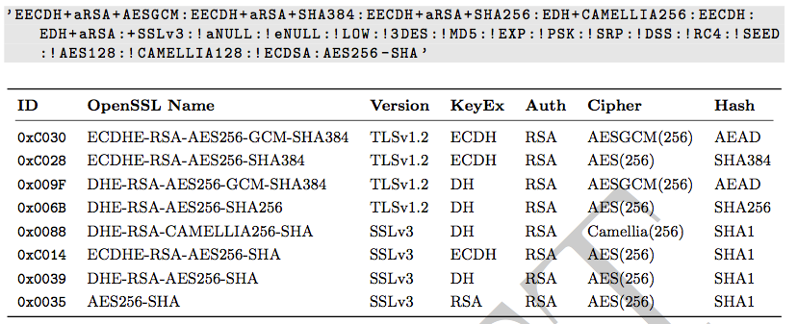
Variant B
weaker ciphers, many clients
Ramin, Daniel

Slide 19
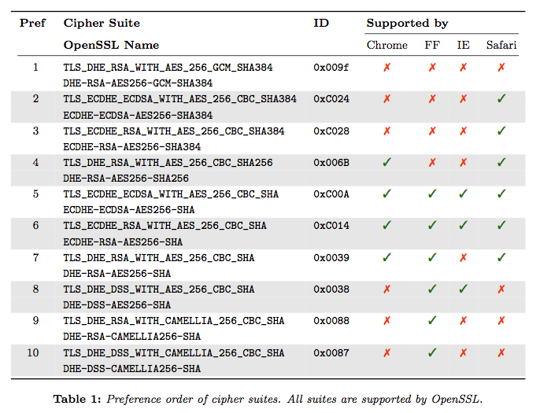
Variant B: Compatibility
TODO aaron: screenshot ssllabs
Ramin, Daniel

Slide 20
Choosing your own cipher string
TODO aaron: zusammenfassen
TODO aaron: Ask Adi

Slide 21
Practical settings
Aaron

Slide 22
What we have so far
Web server: Apache, nginx, IIS, lighttpd
Mail: Dovecot, cyrus, Postfix, Exim, Exchange
DBs: Postgresql, Mysql
Proxies
Aaron

Slide 23
What we would like to see
Mail: Exchange
SSH
VPN: OpenVPN, IPSec, PPTP, Cisco IPSec, Juniper Ipsec, L2TP, Racoon
PGP
IPMI, ILO, ...
SIP
XMPP
DBs: Oracle, DB2
Aaron

Slide 24
Example: Apache
TODO aaron
Aaron

Slide 25
Testing
Aaron

Slide 26
How to test? - Tools
ssllabs.com
xmpp.org
tlstester...
What can people do to test themselves?
What does a test result mean?
Potential for a config file generator (as discussed)?
Aaron

Slide 27
ssllabs
Screenshots
Aaron

Slide 28
Current state as of 2013/11/22
Aaron – TODO write

Slide 29
Participation
Authors: cryptologists, sysadmins, hackers
Apply for write-perms
World-readable
Variantes:
(A) reviewer: the harder job ;-)
(B) co-author: add a section
Aaron

Slide 30
Links
Website: www.bettercrypto.org
Git repo: https://git.bettercrypto.org
Mailing list: http://lists.cert.at/cgi-bin/mailman/listinfo/ach
Aaron

Slide 31
Thank you!
Authors:
TODO... Add more
L. Aaron Kaplan kaplan@cert.at
Manuel Koschuch
Adi Kriegisch adi@kriegisch.at
Christian Mock
Ramin Sabet
Aaron Zauner <azet.org>
Pepi Zawodsky pepi@maclemon.at

